Slide 1


What CTOs Need to Know About Security
SecurityScorecard | Always Know
1

Slide 2

Redis for Security Data
SecurityScorecard JVM Redis Usage
@PaaSDev

Slide 3















SecurityScorecard, in Brief
Founded in 2013 || Security DNA || Top-notch team of 50 || Top Investors
Executive Team
Advisors
Investors
DR. ALEKSANDR YAMPOLSKIY
SAM KASSOUMEH
RICHARD SEEWALD
MARTIN GEDALIN
JOAN FEIGENBAUM
CEO & FOUNDER
COO & FOUNDER
BOARD MEMBER
PARTNER LUMIA CAPTAIL
PROFESSOR
YALE
ALDO CORTESI
PETER Y. LEE
ALFRED BERKELEY
ALEXANDER HEID
SCOTT SCHNEIDER
CEO
NULLCUBE
FMR. PRESIDENT
NASDAQ
EVP SALES
TIBCO
CRO (R&D)
VP Sales
31
Notes:
Update peter BIO – EVP not (sales)

Slide 4
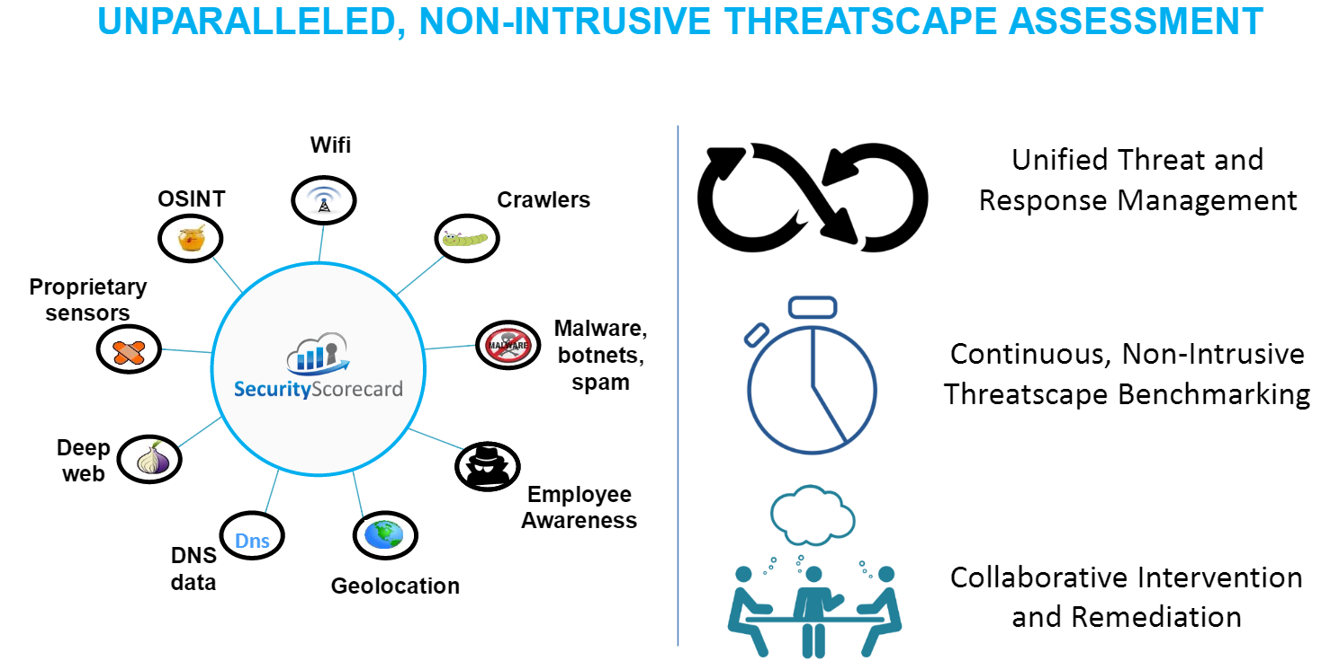
SecurityScorecard can help

Slide 5


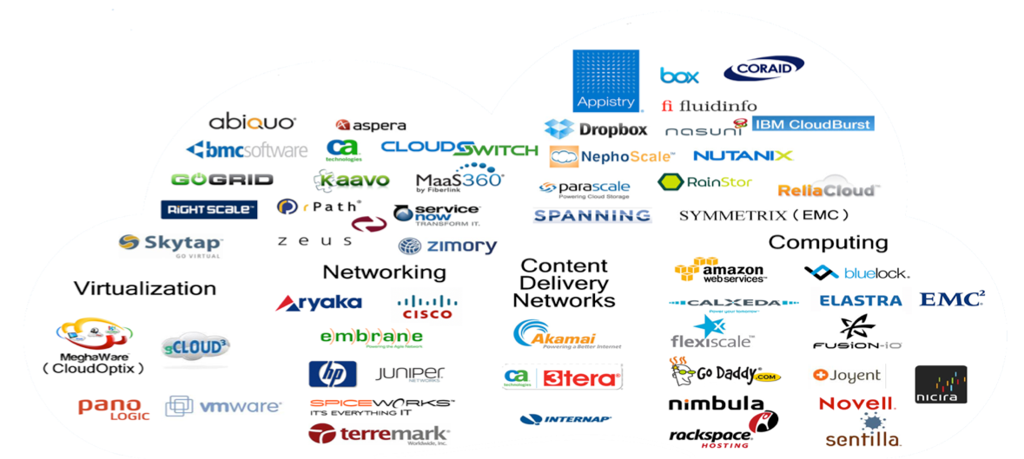


About Me
www.securityscorecard.io

Slide 6
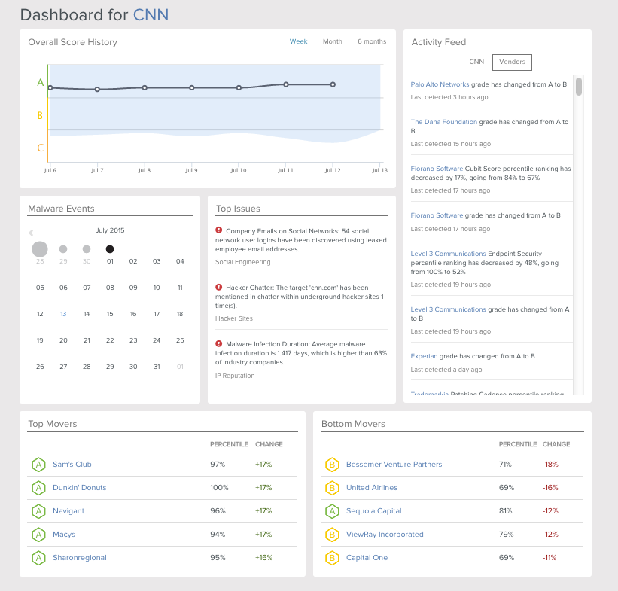

Slide 7

We’re Hiring. Why Work Here?
Well-funded security startup, solving a very big problem in cloud security.
Patented technology utilized in a new way.
Medical/dental/etc. benefits.
Great office space in FlatIron right near subway.
Flexible hours. Top-notch compensation + stock options.
Open Positions:
Front-end Engineer
UI Designer
Data Scientist
DevOps Engineer
Java Developer
Software Engineer
Threat Intel Researcher
VP Engineering
Data Engineer
Contact us @ info@securityscorecard.io

Slide 8

About Me
Senior Software Engineer @ SecurityScorecard
Former Senior Field Engineer @ Pivotal
15+ years of Java Development
DZone Most Valuable Blogger
BS and MS in Computer Science
https://twitter.com/PaaSDev/
http://www.agilemobiledeveloper.com/

Slide 9

Redis is an open source, flexible data store. It does key-value pairs, but a lot more. You can store lists, hash, sets, hyperloglog, bitmaps and sorted sets. This leads to a lot of practice purposes like caching, counters, analytics and storing specialized data.
Redis is a NoSQL store that supports incrementing, appending to strings, adding to lists, set operations and more.
Redis is used for caching in Spring, sessions in Spring and for analytics in Spring XD. Redis is used by many of the Internet giants like Twitter.
Notes:
Runtime can run on be
Standalone
YARN
EC2
Soon CloudFoundry
Hadoop distribution agnostic (support for 8 out of the box)

Slide 10
Features
In order to achieve its outstanding performance, Redis works with an in-memory dataset.
In a shared Redis cluster, every node in the cluster can have multiple shards (Redis servers), each potentially being a slave or a master itself.

Slide 11
Scala + Redis
We are using Redis also with Scala with Akka and Reactive programming.
SBT: ,"net.debasishg" %% "redisreact" % “0.7"
https://github.com/debasishg/scala-redis-nb
// Redis Worker Actor
import com.redis.RedisClient
val redis = RedisClient("localhost", 6379)
val getResult = redis.keys(datasource+":*")
val res = for {
r <- getResult.map(x => SecurityToProcess(x, datasource))
} yield (r)

Slide 12
Scala + Redis
case GetRedisValue(key) => {
log.debug("redis retrieving value for key {}", key)
val getResult = redis.smembers(key)
getResult match {
case Some(res) => res.flatMap(_.toList)
case None => log.error("no result came back key: {}", key)
}
}

Slide 13
Java + Redis
There are many options for working with Java and Redis. Sitting on top of several different
Redis drivers is Spring Data Redis.
Since we use Spring Boot, using Spring Data is a no brainer. It’s fast and easy to use.
Code for Spring Data Redis is nearly identical to code for Spring Data JPA (Postgresql) and
Spring Data MongoDB.
It’s very testable through SpringJUnitRunner and mockable with MockJedis and
NoSQLUnit (EmbeddedRedisTest).
compile 'org.springframework.data:spring-data-redis:1.5.1.RELEASE'
@Autowired
private RedisTemplate<String, String> template;
redisTemplate.boundListOps(userId).leftPush(url.toExternalForm());

Slide 14
Why Redis?
Redis is a great NoSQL engine that is simple to run and use and supports more than just Key-Value storage. It has drivers for every major language.
It can persist data and has more features than Memcache.
We use it for a number of purposes like caching, calculation storage, IP Address lookups, Spring XD analytics and data science applications.
It fits in well with a Lambda architecture and plays well with containers (Docker) and makes a fine storage option for one or more microservices.

Slide 15
Real-Time Data Sources
For real-time ingest of data from sources like Twitter streams or security data, you can using Spring XD to easily stream it to Redis and tap it to go to multiple places like Postgresql, a message queue, HDFS and more at the same time in parallel. With no code, using open source.
Spring XD has prewritten sources for: mongodb, postgresql jdbc, files, ftp, sftp, syslog, mail imap4, file tail, kafka, jms, twitter, cron, reactive streams and more.
Spring XD has stores/sinks for file, hdfs, jdbc, kafka, log, mail smtp, mongo, redis, shell, tcp and more.

Slide 18
Redis SpringXD Sink
stream create --name demoredis1 --definition "http| redis --key=cvStore --collectionType=list --hostname=localhost --port=6379" —deploy
stream create --name demoredis3 --definition "tap:stream:demoredis1 > jdbc --tableName=cvStore" --deploy
stream create --name demoredis4 --definition "tap:stream:demoredis1 > mongodb --databaseName=test --collectionName=cvStore" --deploy

Slide 19
Redis Tools
redis-cli
LLEN cvStore
INFO
MONITOR

Slide 20
SQS
HTTP
Queues
REST Post
Postgresql
MongoDB
JSN
JSON
SQL
Data Ingest
HDFS
Spring XD
Spark / Hadoop
Redis
Filter
REST HTTP
Analytic Model
Transform
Logical Regression
NOSQL
Analytics
SQL
JDBC
HDFS
In-Memory
Stream
Notes:
Sources OOTB: HTTP, Tail, File, Mail, Twitter, Gemfire, Syslog, TCP, RabbitMQ, JMS, Time, MQTT.
Custom Source: Spring Integration. Such as Redis, RSS
http://docs.spring.io/spring-integration/reference/html/feed.html#feed-inbound-channel-adapter
Sinks OOTB: Log, File, HDFS, JDBC (includes HAWQ and GemfireXD), TCP, Mail, RabbitMQ, Gemfire, Splunk, MQTT, Dynamic Router.
Custom Sink: Redis

Slide 21
Big Data Workflow
MongoDB
Message Queue
Redis
Filter
Tap
HDFS
Postgresql

Slide 22

Thanks
Salvatore Sanfilippo and Itamar Haber of Redis Labs, Inc.
Matt Stancliff of Pivotal
Aleksandr Yampolskiy of NY Redis Meetup and SecurityScorecard
Mark Shilshtut of SecurityScorecard for Scala assistance

Slide 23
redis
Salvatore Sanfilippo
Salvatore is the author of Redis
and also started as a security researcher.
He is the author of hping.

Slide 24
Links
http://www.securityscorecard.com/
http://openmymind.net/2012/1/23/The-Little-Redis-Book/
http://projects.spring.io/spring-data-redis/
Using Jedis
Redis Security Tips
http://docs.spring.io/spring-data/data-keyvalue/examples/retwisj/current/
https://www.packtpub.com/books/content/using-redis-hostile-environment-advanced
http://martinfowler.com/articles/microservices.html#SmartEndpointsAndDumbPipes

Slide 25
Links
http://docs.spring.io/spring-xd/docs/current/reference/html/#redis
http://cloudtweaks.com/2015/06/redis-labs-tops-in-independent-nosql-performance-benchmark/
http://www.rediscookbook.org/index.html
https://github.com/50onRed/mock-jedis
https://github.com/knutwalker/rx-redis
http://www.slideshare.net/tobiastrelle/no-sql-testautomation
https://github.com/lordofthejars/nosql-unit
http://martinfowler.com/articles/microservices.html#SmartEndpointsAndDumbPipes

Slide 26
Links
https://pivotallms.biglms.com/courses/PivotalAcademy/RDS101/VP/about
https://pivotallms.biglms.com/courses/PivotalAcademy/SDC202/VN/about
http://www.javacodegeeks.com/2015/03/spring-xd-for-data-ingestion.html
http://springxd.ninja/2015/03/09/spring-xd-setup/
http://redis.io/topics/security
http://martinfowler.com/articles/microservices.html#SmartEndpointsAndDumbPipes

